Slide 1
RESTAURANT ORDERING & BILLING SYSTEM

Slide 2
TABLE OF CONTENTS
01
03
05
02
04
INTRODUCTION
PROGRAM FLOW
ER-DIAGRAM
07
06
REPORTS
SYSTEM ARCHITECTURE
PRIVILAGES
ORDER
&
BILLING WORKFLOW

Slide 3
INTRODUCTION
The system automates restaurant operations such as ordering, billing, stock management, discounts, and reporting using Python and MySQL.
It provides secure role-based access for Manager, Admin, Waiter, and Cashier, ensuring each user can access only their assigned functions.
The system maintains real-time updates for orders, billing, GST, discounts, and inventory, while storing all data in a structured MySQL database.
It also includes reporting, CSV export, and audit logging features, making the system efficient, transparent, and suitable for real-world restaurant management.

Slide 4
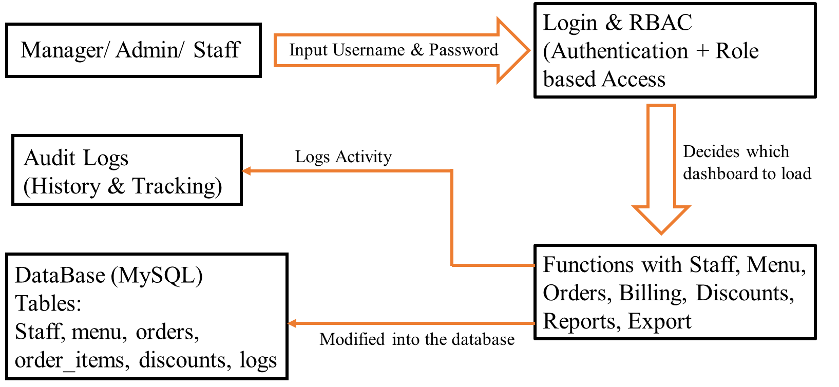
SYSTEM ARCHITECTURE
Login & RBAC (Authentication + Role based Access

Slide 5
PROGRAM FLOW
START
Login Screen
|
Validate Credentials (DB Check)
-----If Invalid Show Error Back to Login
-----If valid
Load Role Dashboard
Manager Admin/ Staff/ Discount/ Reports
Admin Menu/ Staff/ Reports
Waiter Orders/ Modify/ Close
Cashier Billing/ Export
Execute Selected Operation
Update Database
Recalculate Totals (If billing)
Log Action (Audit Train)
Logout
End

Slide 6
PRIVILAGES
Features | Manager | Admin | Waiter | Cashier
Create Admin | YES | NO | NO | NO
Add Staff | YES | YES | NO | NO
Activate / Deactivate Staff | YES | YES | NO | NO
View Admins | YES | NO | NO | NO
View Audit Logs | YES | NO | NO | NO
Menu Management | NO | YES | NO | NO
Revenue Reports | YES (Full) | YES (Limited) | NO | NO
Take / Modify Orders | NO | NO | YES | NO
Close Orders | NO | NO | YES (Own orders only) | YES (All Orders)
Export Bills | YES | YES | YES (Own orders only) | YES
View Menu | YES | YES | YES | NO

Slide 7
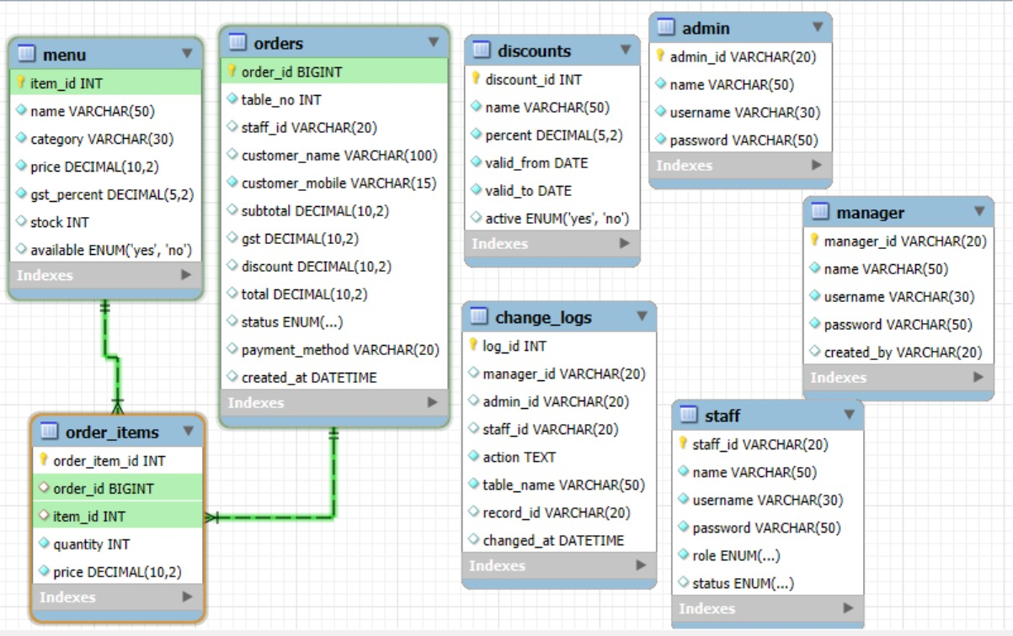
ER-DIAGRAM

Slide 8
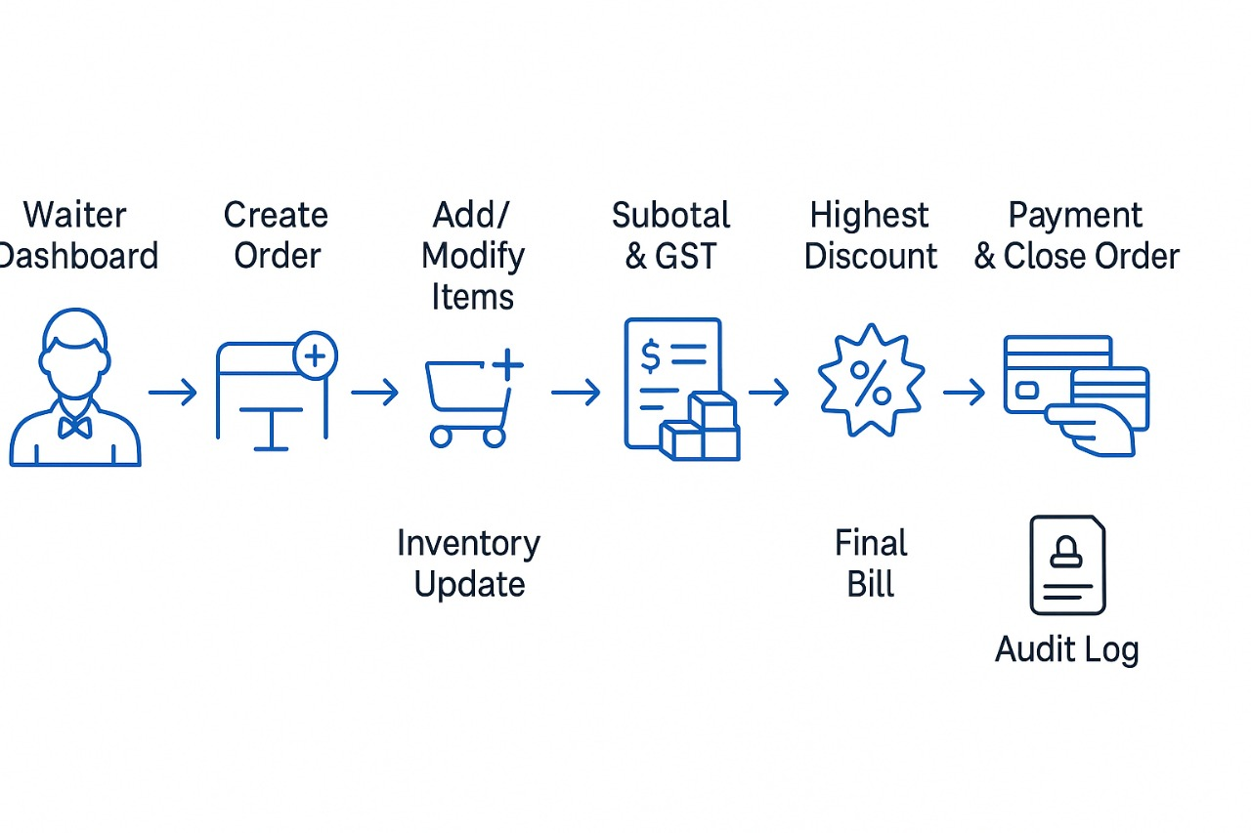
ORDER & BILLING WORKFLOW

Slide 9
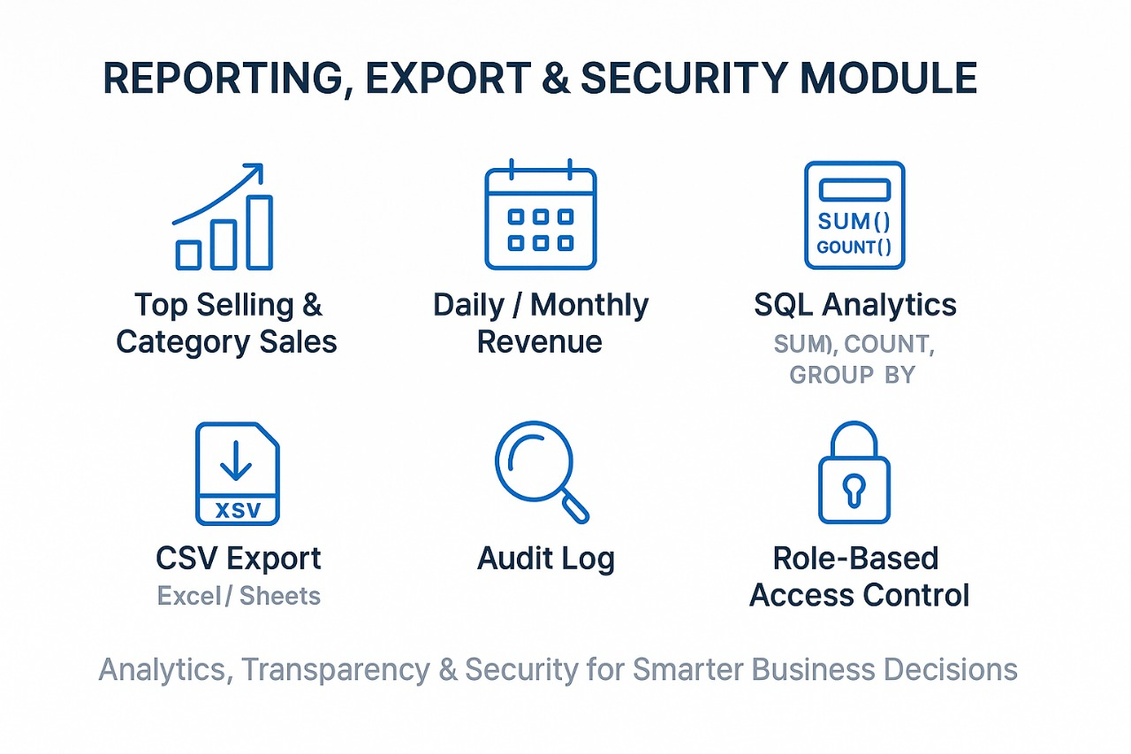
REPORTS

